Slide 1
Telecom Customer Churn Prediction
Reducing Attrition through Machine Learning & Statistical Analysis

Slide 2
Executive Summary
Goal: Predict which customers are likely to leave (churn) to allow for proactive retention strategies.
Key Results: Churn Rate: 26.5% of the customer base is at risk.
Model Performance: Logistic Regression achieved 80% accuracy.
Primary Drivers: Contract terms and service type are the strongest predictors of churn.

Slide 3
Data & Methodology
The Dataset: 7,043 customer records with 21 features (Demographics, Services, and Billing).
The Approach:
Cleaned and preprocessed data (handled missing values, encoded categories).
Used Mutual Information (MI) and Entropy analysis to identify the most influential features.
Built a Logistic Regression model to classify "Churn" vs. "No Churn."

Slide 4
Key Statistical Insights
Feature Importance (MI Scores):
Contract Type: The #1 predictor. Customers on month-to-month plans are significantly more likely to leave.
Online Security & Tech Support: Customers without these services show much higher churn rates.
Internet Service: Fiber optic users churn at a surprisingly higher rate than DSL users (suggesting possible service or price dissatisfaction).

Slide 5
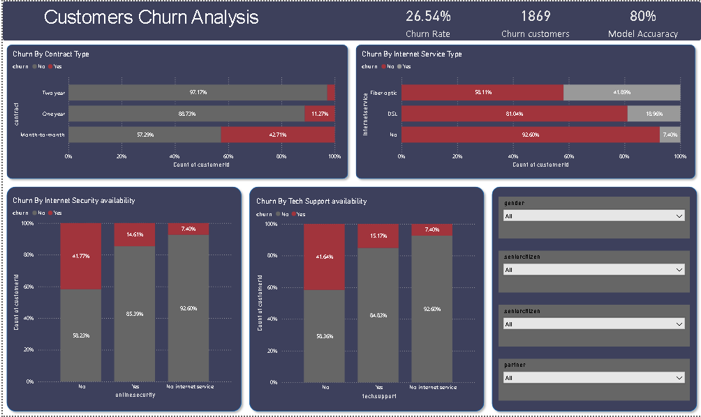
Dashboard Insights

Slide 6
Dashboard Insights
Segment High-Risk: Highlight the 42.7% churn rate in Month-to-month contracts.
Technical Gaps: Point out that customers with no Online Security have a 41.7% churn rate compared to only 14.6% for those who have it.
Demographic Slicers: Note that while Gender/Senior status are filterable, they have low statistical impact compared to service-related features.

Slide 7
Model Results
Accuracy: 80% (Tested on unseen data).
Top Insights from the Model:
Short tenure + Month-to-month contracts = Highest Risk Profile.
Fiber optic service is a "churn magnet" in the current pricing/service structure.
Model Utility: This model allows the marketing team to target the 1,869 "at-risk" customers identified in the dashboard.

Slide 8
Strategic Recommendations
Convert Contracts: Incentivize month-to-month users to move to 1 or 2-year contracts.
Bundle Security: Offer "Online Security" or "Tech Support" as a free trial or low-cost add-on to increase customer "stickiness".
Fiber Optic Audit: Investigate why Fiber Optic churn is so high (is it price? downtime?) and address the service gap.
Proactive Outreach: Use the model’s prediction list to offer discounts to high-probability churners before they cancel.

